Slide 1
Research Methodology- Unit 4 Measurement, Scaling and Sampling
Prime College- BIM 6th Semester

Slide 2
Research Methodology- Unit 4 Chapter 2- Construction of Scales
Prime College- BIM 6th Semester

Slide 3


Learning Outcome
Objective Test and Social Scales
Scales and Indexes
Techniques for Developing Attitude Scales
Construction of Attitude Scales
Likert Scale
Thurston Scale
Guttman Scale
- Attitude Rating and Ranking Scales

Slide 4
Objective Test and Social Scales
A test is a systematic procedure in which an individual response is assigned a set of constructed stimuli. Such responses enable the tester to assign a numeral or set of numerals to the event object or person. Such numerals are used to make inferences about the possession of whatever the test measures.
A scale is a set of symbols or numerals constructed by rules to differentiate the individual’s behavior to which the scale is applied. A scale is a measure used to capture the intensity, direction, level, or potency of a variable construct.
In a broader sense scale is used for two purposes:
to indicate a measuring instrument and
 to indicate the systematized numerals of the measuring instrument
Scales are commonly used to measure how an individual feels or thinks about something, i.e., hardness or potency of feeling. It is equally helpful in the process of conceptualization and operationalization.
It is helpful for every social researcher because it produces quantitative measures required for testing hypotheses.
It is said that, to some extent, tests are scales, but scales are not necessarily tests because they do not have the meaning of competition, success, or failure that tests do, like testing achievement but not achievement scaling.

Slide 5
Scale and Indexes
A scale is a measure that is used to estimate the intensity, direction, level, or potency of a variable construct.
Index, on the other hand, is a measure in which a researcher adds or combines several distinct indicators of a construct into a single score.
The index is the aggregate value that gives an idea about the degree or extent of intensity of respondents to the variables. Index and scale may be confusing because they are often used interchangeably. One researcher's scale can be another's index.
Index and scale produce ordinal or interval level measures of a variable.
Scale and index techniques can be combined in one measure to add to the confusion. They give more information to the researcher about variables and make it possible to assess the measurement quality.
Scales and indexes increase reliability and validity, and they aid in data reduction; that is, they condense and simplify the information that is collected (Neuman, 2006).

Slide 6
Techniques for Developing Attitude Scales
i. Multiple choice: Respondents get several alternatives representing their attitude towards the given statement under this technique. Respondents were required to choose the best alternative towards which they preferred more. It is assumed that the respondent prefers the alternative over the other.
ii. Rating: Under this technique, respondents are asked to give a specific value to the given alternative concepts. Respondents estimate their value, i.e., the magnitude of characteristics like quality, quantity, reliability, serviceability, etc. The respondent's rate indicates the respondent's position on a scale.
iii. Ranking: Under the ranking technique, respondents give the order position for the given characteristics, i.e., alternatives. Rank indicates the priority among the alternatives as a priority, second priority, and so on. From this, the researcher can understand the various attitudes of respondents on the priority.
iv. Sorting: Under this technique, respondents are given several alternative concepts typed on the cards or serial numbers. They must arrange the alternative based on their priority or value over others. This helps to classify the concepts
Notes:
An attitude scale is a questionnaire that measures a person's feelings or beliefs about a specific topic, event, or object. Attitude scales are used in research and surveys to gather data on a variety of topics, such as political issues, health behaviors, and consumer products. The data collected can help researchers understand people's perceptions, beliefs, and intentions.

Slide 7
Construction of Attitude Scales
Summated Rating Scales (Likert scales)
Thurstone Scales or Differential Scales
Guttman Scales (Cumulative scales)

Slide 8
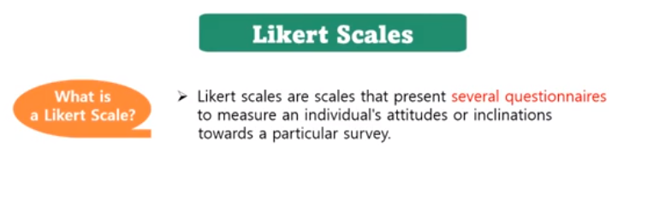
Summated Rating Scales (Likert scales)
Notes:
https://www.youtube.com/watch?v=1DZ3yjOZZ08

Slide 9
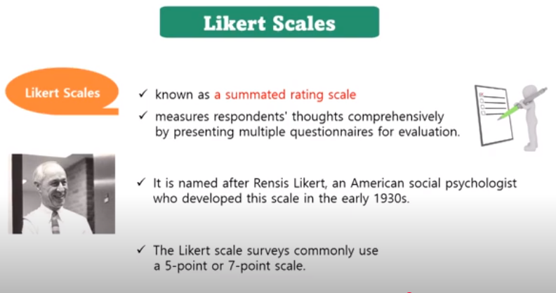
Summated Rating Scales (Likert scales)
Notes:
https://www.youtube.com/watch?v=1DZ3yjOZZ08

Slide 10
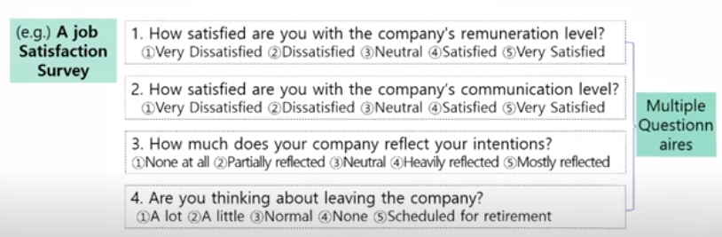
Summated Rating Scales (Likert scales)
Notes:
https://www.youtube.com/watch?v=1DZ3yjOZZ08

Slide 11
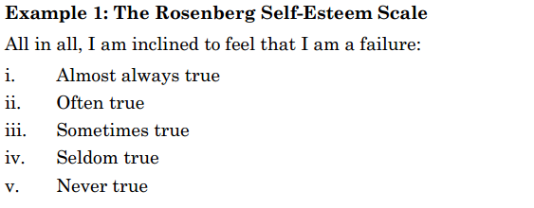
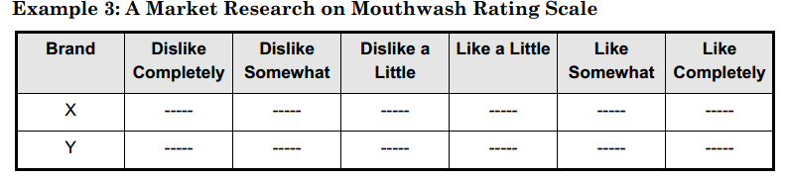
Summated Rating Scales (Likert scales)
Notes:
https://www.youtube.com/watch?v=1DZ3yjOZZ08

Slide 12
Summated Rating Scales (Likert scales)
Miller (1970) suggested the following considerations for the construction of the Likert scale:
i. Nature: This is a summated scale consisting of a series of items to which the
subject responds. The respondent indicates his or her agreement or
disagreement with each item on an intensity scale. The Likert technique
produces an ordinal scale, which generally requires non-parametric statistics.
ii. Utility: This scale is highly reliable regarding a rough ordering of people about
a particular attitude or attitude complex. The score includes a measure of
intensity as expressed in each statement.
Notes:
https://www.youtube.com/watch?v=1DZ3yjOZZ08

Slide 13
Summated Rating Scales (Likert scales)
Construction of Likert scale
 The investigator assembles many statements considered relevant to the attitude being investigated, either favorable or unfavorable.
 A prior test is made after assembling the statements with a small group of respondents by asking their level of response on each statement. This helps to finalize the point scale, i.e., four/five/seven or more.
 Scale points, i.e., 5, 4, 3,2, 1, are assigned to the response from most favorable to least favorable, respectively.
 Each individual's total score is computed by adding his or her item score.
 The responses are analyzed to determine which items differentiate most clearly between the highest and lowest qualities of the total score. This helps to identify a few groups representing the most favorable and the least favorable attitudes.
 Only those statements that correlate with the total test should be included in the final instrument, and the others should be discarded from the final instrument.
Notes:
https://www.youtube.com/watch?v=1DZ3yjOZZ08

Slide 14
Thurstone Scales or Differential Scales
Thurstone scales, developed by L. L. Thurstone, use the law of comparative judgment. Under this approach, required items are selected and sorted into various categories along a continuum by a panel of judges. The items are evaluated based on the relevancy of the topic area, the potential for ambiguity, and the level of attitude they represent.
The law of comparative judgment states that it is possible to identify the 'most common responses' for each object or concept being judged.
In Thurstone scaling, the researcher develops many response statements that may be more than a hundred regarding the area of interested objectives, then lets the panel of judges reduce them to a small number to less than twenty by eliminating ambiguous and irrelevant statements. Each judge rates the statement on an underlying continuum, e.g., favorable to unfavorable.
Then, the researcher examines the ratings and keeps statements based on two factors: Agreement among the judges and the statement's location on a range of possible values. The final set of statements is a measurement scale that spans a range of values
Notes:
https://www.youtube.com/watch?v=1DZ3yjOZZ08
https://www.youtube.com/watch?v=1DZ3yjOZZ08&t=197s

Slide 15
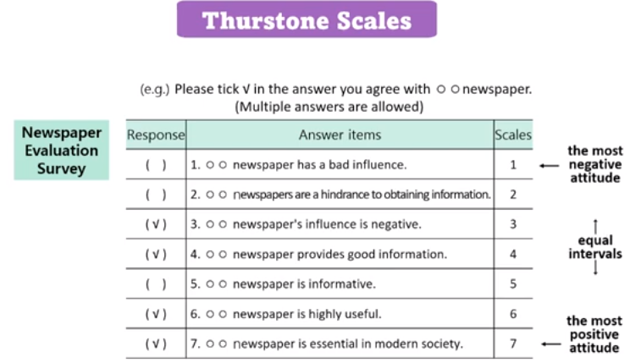
Thurstone Scales or Differential Scales
Notes:
https://www.youtube.com/watch?v=1DZ3yjOZZ08

Slide 16
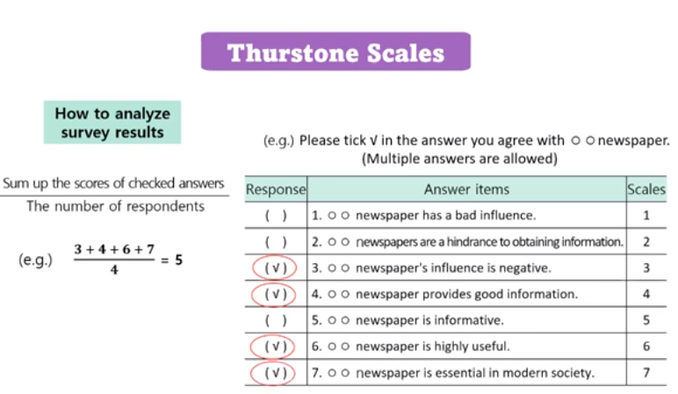
Thurstone Scales or Differential Scales
Notes:
https://www.youtube.com/watch?v=1DZ3yjOZZ08

Slide 17
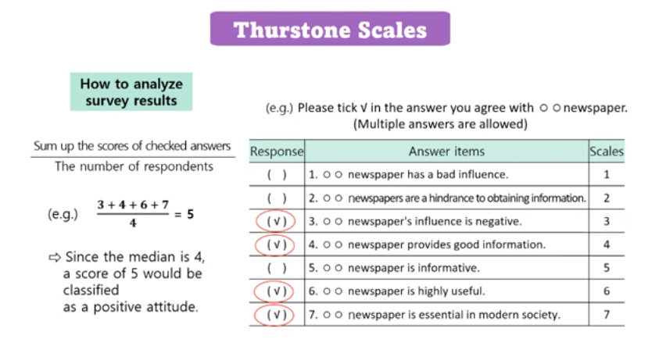
Thurstone Scales or Differential Scales
Notes:
https://www.youtube.com/watch?v=1DZ3yjOZZ08

Slide 18
Likert Scales VS Thurstone Scales
For example, a retailer may send a customer a short survey to understand their feelings about a recent visit to their store. If using the Likert scale, the survey would pose a statement: “I was satisfied with my visit today.”
Likert Scale
Respondents could select an answer from an agree/disagree scale (e.g., strongly agree, somewhat agree, neither agree nor disagree, somewhat disagree, or strongly disagree).
Thurstone Scale
If using the Thurstone method, the respondent would only have two answer options: agree or disagree.
Notes:
https://www.youtube.com/watch?v=1DZ3yjOZZ08

Slide 19
Thurstone Scales or Differential Scales
Miller (1970) suggests the following considerations for the construction of Thurstone scales:
Nature: This scale consists of several items whose position on the scale has been determined previously by a ranking operation performed by judges. The subject selects the responses that best describe how he or she feels.
ii. Utility: This scale approximates an interval level of measurement. This means that the distance between any two numbers of the scale is of known size. Parametric and non- parametric statistics may be applied.
Notes:
https://www.youtube.com/watch?v=1DZ3yjOZZ08

Slide 20
Thurstone Scales or Differential Scales
Limitations of Thurstone scale
 It helps measure agreement and disagreement regardless of its intensity.
 It assumes the agreement of a panel of judges upon the constructed statements that appear in a rating system.
 It is possible to get the same overall score in several ways because agreement or disagreement with different combinations of statements can produce the same average.
Notes:
https://www.youtube.com/watch?v=1DZ3yjOZZ08

Slide 21
Guttman Scales (Cumulative scales)
Louis Guttman developed this scaling technique in the 1940s.
Like Likert and Thurstone scales, Guttman scales also consist of sets of items but are relatively small sets of homogenous items that are supposed to be one-dimensional.
This scale covers only one variable but exerts a cumulative relation between items and the total scores of an individual.
Guttman scales determine whether the relationship exists among indicators or measurements.
He used multiple indicators to document a construct's underlying single dimension or cumulative intensity.
Notes:
https://www.youtube.com/watch?v=1DZ3yjOZZ08

Slide 22
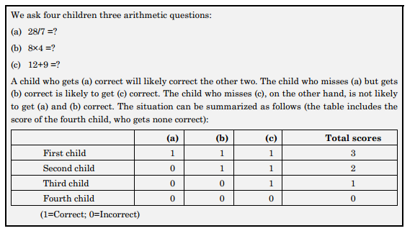
Example of Guttman Scales (Cumulative scales)

Slide 23
Guttman Scales (Cumulative scales)
In the Guttman scale, measuring a set of items or indicators are probably questionnaire items, votes, or observed characteristics and simply measures in yes/no, present/absent fashion.
As we analyze the earlier given example, it is easier to give the correct answer of (c) than that of (b) and (a). If we ask a child to tell his name, home's telephone number, and the names of three political leaders, it is evident that the child can tell his name more quickly than that of his home's telephone number and the names of three political leaders. Hence, if the items are developed in hierarchical order, only it is scalable and possible to form Guttman scales.
Notes:
https://www.youtube.com/watch?v=1DZ3yjOZZ08

Slide 24
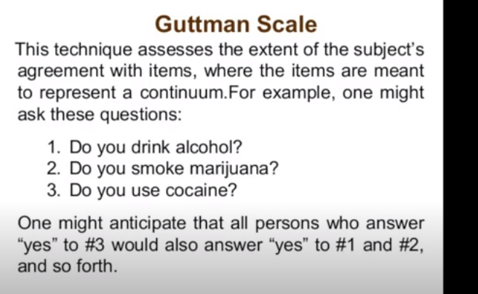
Example of Guttman Scales (Cumulative scales)

Slide 25
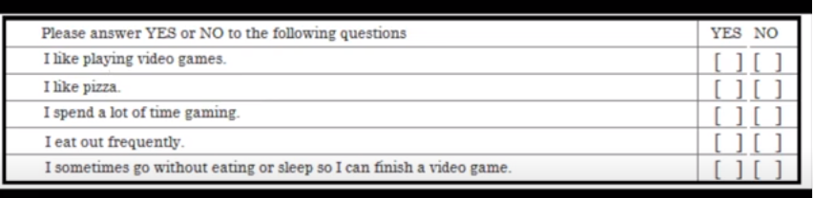
Guttman Scales (Cumulative scales)

Slide 26
Guttman Scales (Cumulative scales)
Following are the considerations provided by Miller (1970) for the construction and use of the Guttman scales or cumulative scales:
Nature: The Guttman technique attempts to determine the scale's unidimensionality. Only items meeting the criterion or reproducibility are acceptable as scalable. If a scale is one-dimensional, then a person who has a more favorable attitude than another should respond to each statement with equal or greater favorableness than the other.
ii. Utility: Each score corresponds to a similar response pattern or scale type. It is one of the few scales where the score can be used to predict the response pattern to all statements. Only a few statements (five to ten) are needed to provide a range of scalable responses.
Notes:
https://www.youtube.com/watch?v=1DZ3yjOZZ08

Slide 27
End of Chapter 2
(Click the arrow when in Slide Show mode)
Notes:
In Slide Show mode, click the arrow to enter the PowerPoint Getting Started Center.

